Slide 1
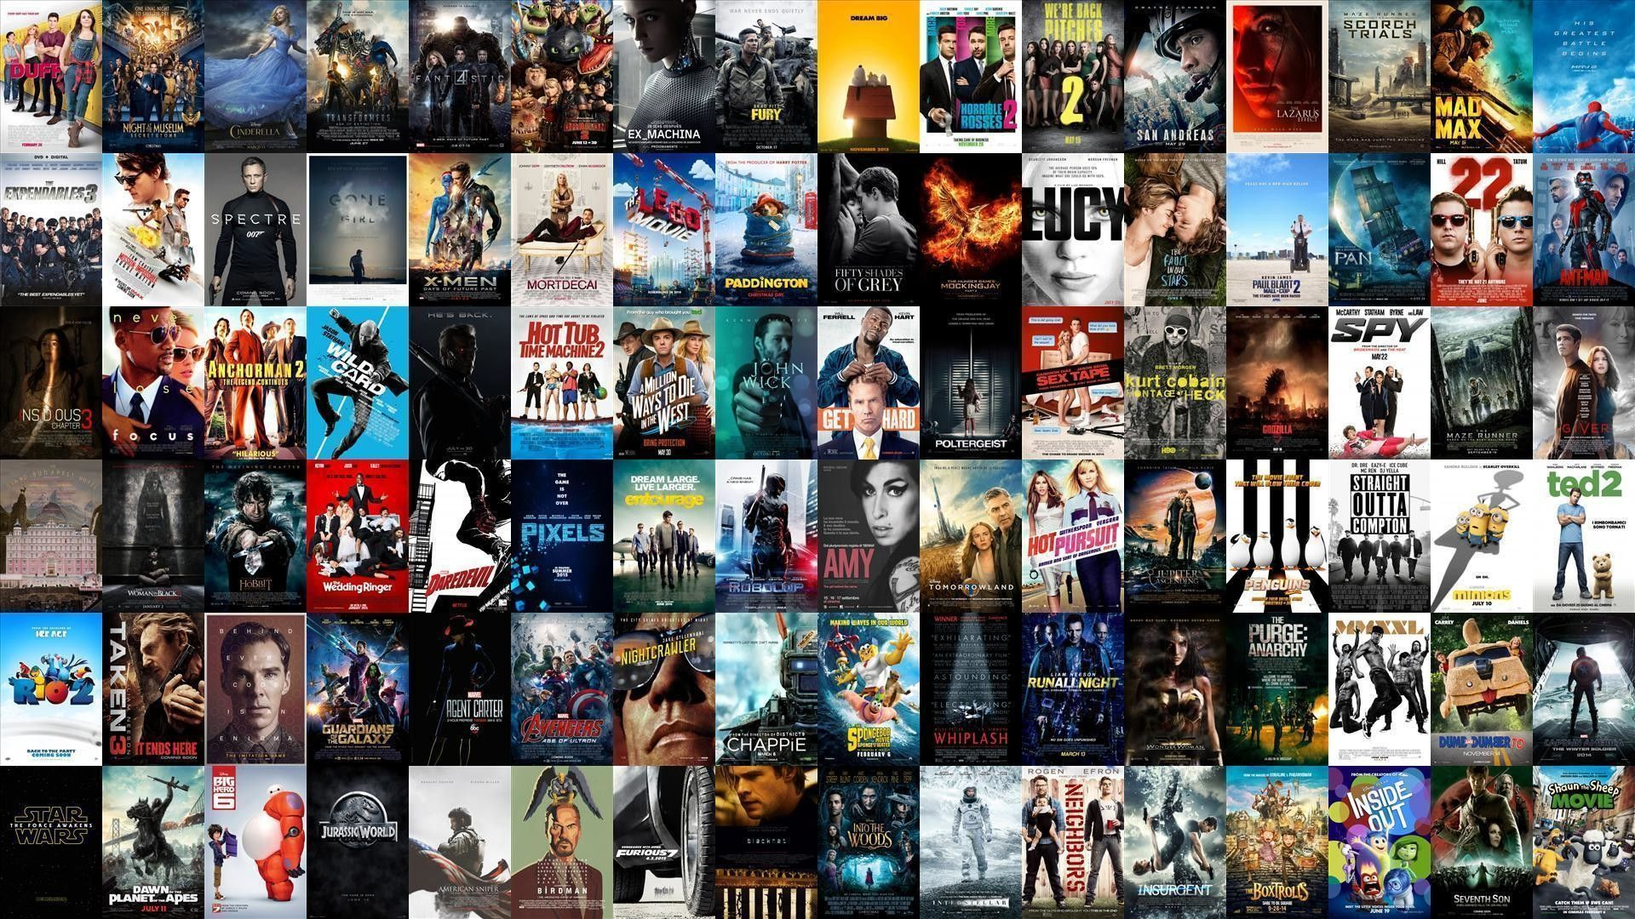
NETFLIX
DATA ANALYSIS
→ K SESHA SAI SREYA
→2206DSP183

Slide 2
CONTENTS:
INTRODUCTION
PROJECT DETAILS
TRENDS DISCUSSED IN PROJECT
RESULT AND ANALYSIS
CONCLUSION AND FUTURE SCOPE

Slide 3
INTRODUCTION

Slide 4
Netflix is one of the largest providers of online streaming services. It collects a huge amount of data because it has a very large subscriber base.

Slide 5
With over 203.67 million subscribers worldwide, Netflix has reigned as the no.1 Over-the-Top (OTT) streaming content platform since its launch in 2007. The secret to Netflix’s success is Data and analytics.

Slide 6
PROJECT DETAILS

Slide 7

Provide users with personalized movie and TV show recommendations
Predict the popularity of original content to before it greenlights it (or not)
Personalize marketing content such as trailers and thumbnail images
Optimize production planning
Enhance general technical and business decision making

Slide 8

Data analysis is hence known to be a scientific process solely focused on the data as its subject. It begins with retrieving data from various external-cum-internal sources and then performing intrinsic analysis with the data in order to discover and obtain beneficial information catering the needs of an entity. Based on the nature and characteristic of data Fundamentally, there are two primary methods for data analysis
qualitative data analysis
quantitative data analysis

Slide 9

“Data is the new oil.”
The fact that there is a constant need for intelligent solutions with data as inputs cannot be neglected. Due to these changes, we have witnessed a paradigm shifts in almost every single field around the world.
One such field is the entertainment industry that had a rapid transposition as the industry soon began to adopt virtual methods for releasing its content.
The Over-The-Top (OTT) to provide and deliver content has gained huge prominence around the world. One of the key players in the game being Netflix, has changed the way people subject themselves to entertainment.
The from-home-all-in-one package type subscription services that these OTT platforms has to offer had customers glued to them quite literally. All these behavioral information about large base of customers is essentially a valuable data.

Slide 10
TRENDS DISCUSSED
IN
PROJECT

Slide 11
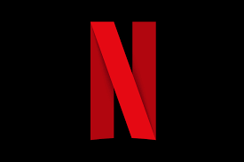
Netflix uses Data Science and Bigdata Analytics in their recommendation systems. In late 1990’s, the term recommender system was introduced for the first time in literature of information system .
The interest in recommendation system remains as it is widely applicable to solve the practical problems of many companies. Many companies like amazon, Microsoft etc. have a commercial recommendation system.

Slide 12
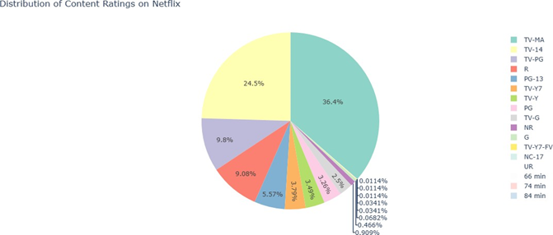
Distribution Of Content Ratings On Netflix:

Slide 13
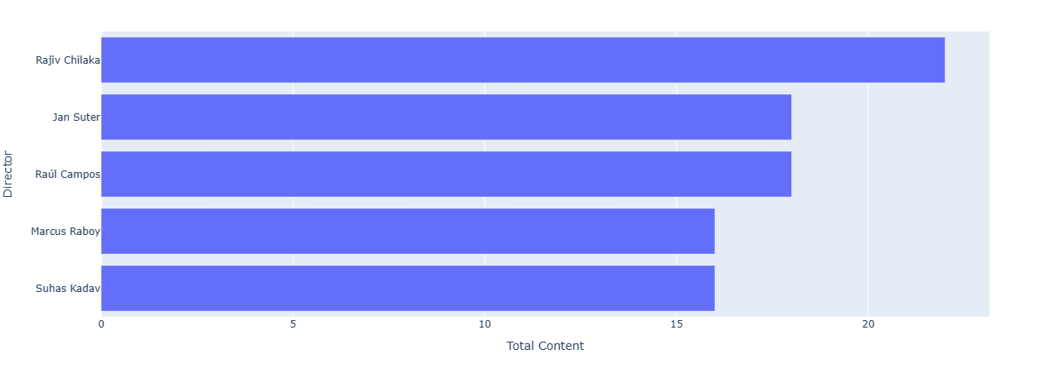
TOP 5 DIRECTORS OF NETFLIX:

Slide 14
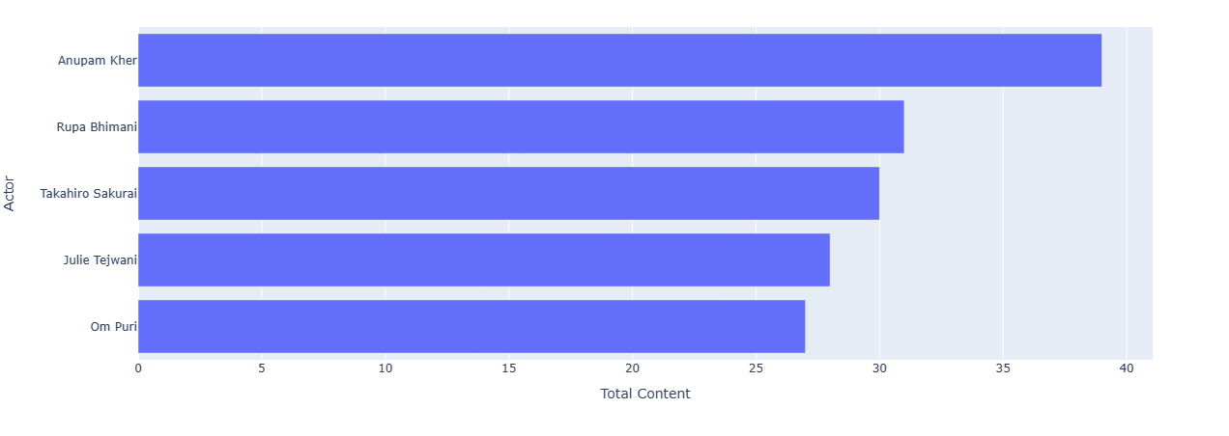
TOP 5 ACTORS OF NETFLIX:

Slide 15
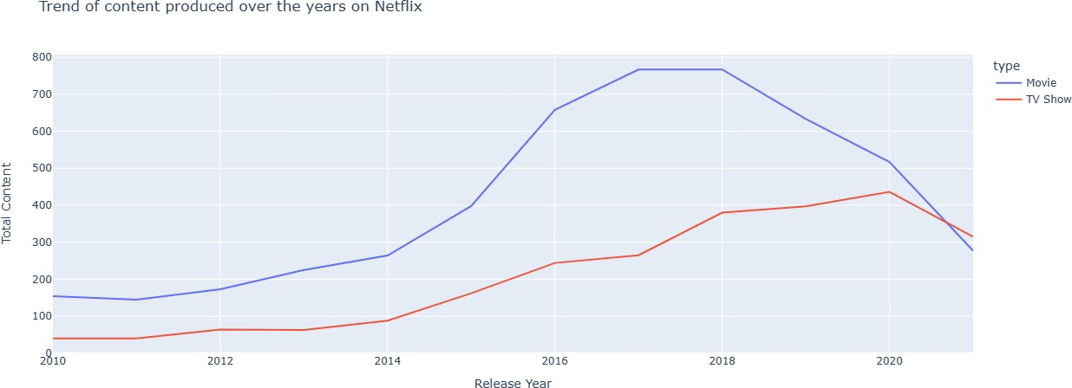
THE TREND OF PRODUCTION OVER THE YEARS ON NETFLIX:

Slide 16
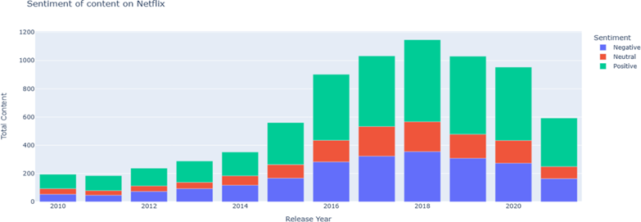
SENTIMENT OF CONTENT ON NETFLIX:

Slide 17
RESULT
AND
ANALYSIS

Slide 18

The Netflix data we have garnered some crucial insights for other useful purposes. The following are summarized points:
We have successfully cleaned the redundant records by removing them, and filtered the Data Set by discarding unused features
We developed a correlation amongst the utility features and established a guidance for our analysis
Built a plotting for size of Series & Movies in the dataset
Derived the top 5 directors top 5 actors, on this platform.
Built a Sentiment Analysis Model by fitting the Series/Movie Reviews dataset, which obtains the result by making use of the summary column in the Netflix dataset.

Slide 19
Data analysis is a fundamental step to address the various needs of a client in any professional spectrum. The varied range of insights that can be derived from a data is itself primarily valuable in nature as there are multiple businesses that are actively looking for futuristic, predictive, and descriptive insights from the already present raw data generated by them. It helps the organizations to gain access to numerous concealed patterns, information, and bits of knowledge after the analysis had been performed.

Slide 20
CONCLUSION
&
FUTURE SCOPE

Slide 21

The analysis that we have just performed using the Netflix data not only provides us with incentives to take smart and intelligent business decisions, but also contribute to the overall growth of the firm. These insights maintain a clear sight and perspective for various stakeholders and help in targeting a positive vision for the future.

Slide 22
The future scope of Data Analysis is bound to remain intact if businesses require Data Science in their everyday applicable decision-making processes. Also, there is a great scale of possibilities when it comes to developing unique interactive solutions and methods that are confined to make data exploration much more intriguing in nature. These constant advancements have stabilized a promising direction for data analysis as a systemic study that is going to stay if there is the crunch for data in any viable field of study in the real-world.

Slide 23
THANK YOU

